Slide 1
Customer Churn Prediction & Lifetime Value Analytics Platform
Data Analyst Capstone Project
Tools Used
Python
SQL
Power BI
Machine Learning
FastAPI

Slide 2
Business Problem Statement
Customer churn causing revenue loss Company
Unable to identify churn-risk customers
No customer value prioritization
Need data-driven retention strategy

Slide 3
Project Objectives
Predict customer churn
Identify churn drivers
Calculate Customer Lifetime Value (LTV)
Create Business Intelligence dashboards
Build API for prediction service
Support business decision making

Slide 4
Dataset Overview
Dataset:- Telco Customer Churn Dataset
Key Facts:-
Total Records = 7043
Final Records = 7032
Target Variable = Churn
Important Columns:-
tenure
contract
internet_service
payment_method
monthly_charges
total_charges
churn

Slide 5
Data Cleaning & Preprocessing
Missing value handling
TotalCharges datatype correction
Removed 11 invalid records
Duplicate check
Data validation
Final Shape:-
7032 × 21

Slide 6
Exploratory Data Analysis (EDA)
Key Findings:-
Churn Rate = 26.58%
Month-to-month customers churn highest
Fiber optic customers churn higher
Electronic check customers churn highest
Low tenure customers more likely to churn

Slide 7
Feature Engineering
Created Features:-
Churn_Flag
Tenure_Group
Monthly_Charge_Group
Customer_Value_Segment
High_Risk_Flag
Business Benefit:-
Improved model understanding and customer segmentation

Slide 8
Machine Learning Modeling
Models Developed:-
Logistic Regression
Logistic Regression + SMOTE
Random Forest
Random Forest + SMOTE
XGBoost
XGBoost + SMOTE

Slide 9
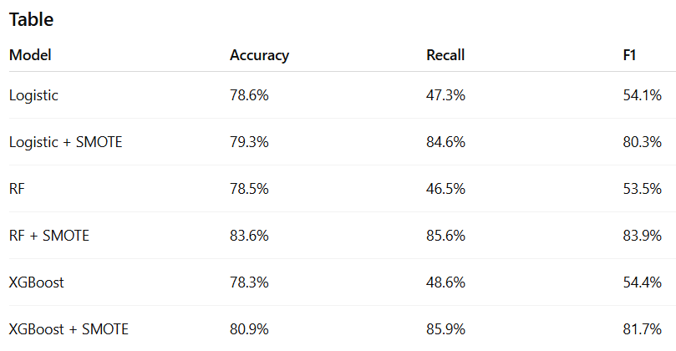
Model Performance Comparison

Slide 10
Best Model Selection
Selected Model:-
Random Forest + SMOTE
Performance:-
Accuracy = 83.6%
Precision = 82.2%
Recall = 85.6%
F1 Score = 83.9%

Slide 11
Top Churn Drivers
Top Features:-
MonthlyCharges
tenure
TotalCharges
Contract
OnlineSecurity

Slide 12
Customer Lifetime Value Analysis
Formula:-
LTV = MonthlyCharges × Tenure
Segments:-
Low Value
Medium Value
High Value
Premium Value
Key Finding:-
Premium customers generate maximum revenue.

Slide 13
Business Intelligence Dashboards
4 dashboard:-
Executive Overview
Churn Intelligence
LTV & Revenue
ML Performance
Key Benefit:-
Business-friendly decision support.

Slide 14
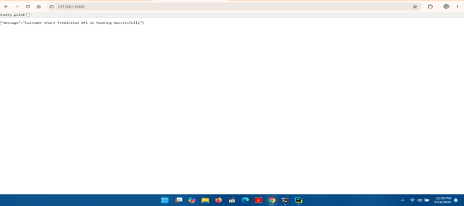
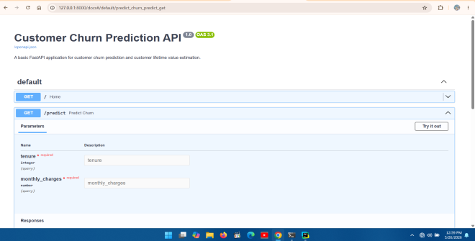
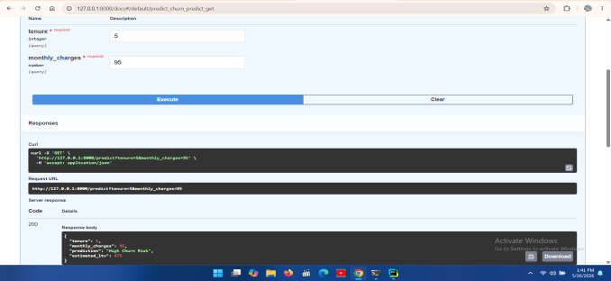
API Development & SQL Validation
API:-
FastAPI
Swagger UI
Churn Prediction Endpoint
LTV Estimation Endpoint
SQL:-
Churn validation
Revenue validation
LTV validation
Key Result:-
Python + SQL + Power BI outputs fully aligned.

Slide 15
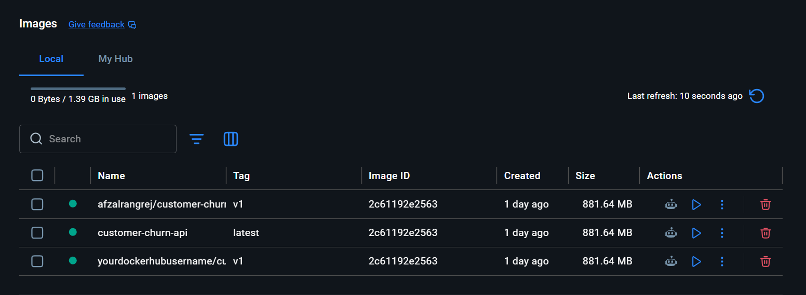
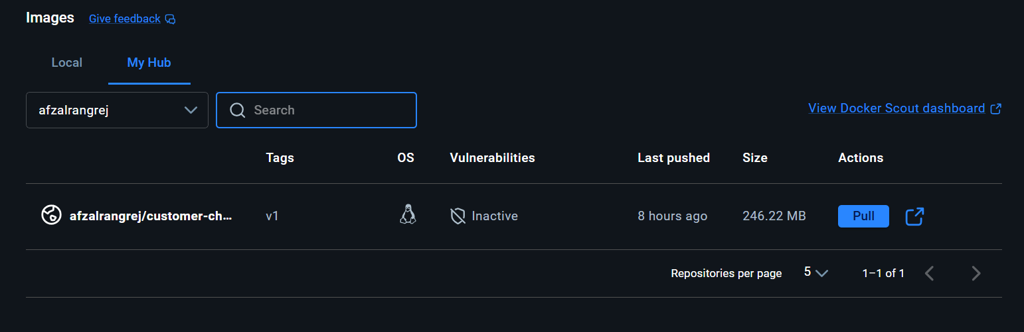
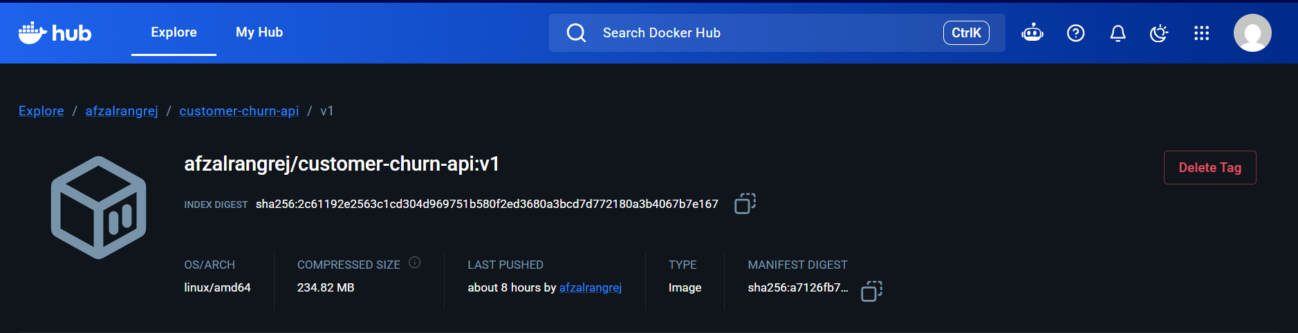
API DEPLOYMENT WITH DOCKER

Slide 16
Business Impact & Conclusion
Impact:-
Identify churn-risk customers
Protect premium customers
Improve retention strategy
Reduce revenue loss
Support data-driven decisions
Final Conclusion:-
Built a complete end-to-end Customer Churn Prediction & Lifetime Value Analytics Platform using Python, SQL, Machine Learning, Power BI, and FastAPI.

Slide 17
THANKYOU

